Slide 1
CONTROLLING THE PRIMARY MIRROR
IN A SPACE BASED TELESCOPE UTILIZING ON EIGENSTRUCTURE
ASSIGNMENT TECHNIQUE
Capt. Kim Kyongsoo
Advisor Maj. Cobb
March 2004

Slide 2
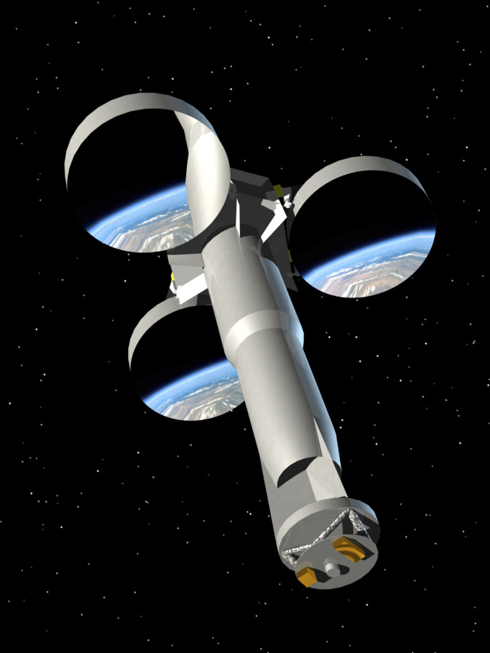
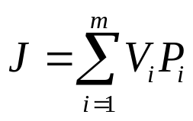

Problem Statement cont’
Maintaining the Focus of Primary Mirror
  Vibration control/Disturbance Rejection
Objective Function
  V_{i} : variance of the i^{th} output (tip, tilt, piston)
  P_{i} : Penalty of i^{th} output
Goal: How to select the control gain matrices such that it minimizes the objective function
Method: Use Eigenstructure Assignment

Slide 3
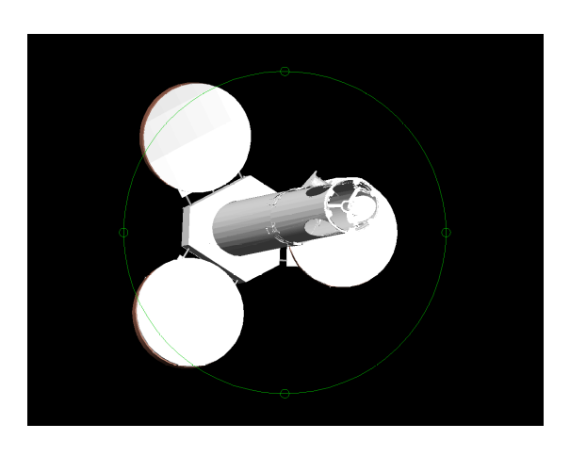
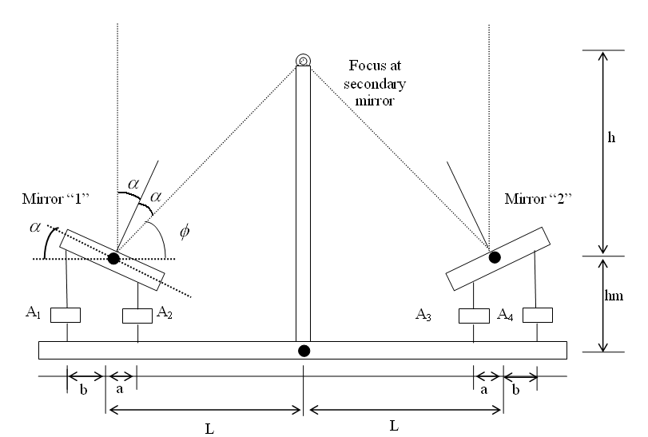
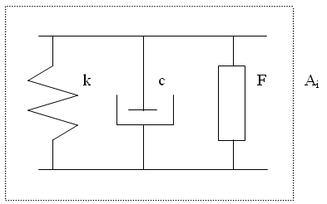
Developing EOMs
Proposed flight hardware

Slide 4
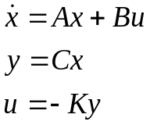





Methodology
Developing Eigenstructure Assignment
  Output Feedback
  Closed-loop eigenstructure
    System has ‘n’ states, ‘m’ inputs and ‘r’ outputs
General rules
    The value of max(m,r) closed-loop eigenvalue can be arbitrarily assigned
    If max(m,r) then the eigenvalue cannot be assigned.
    The shape of the closed-loop eigenvectors associated with the assigned eigenvalues can be assigned as well. A total of min(m,r) elements of each assigned eigenvector can be chosen arbitrarily.
where

Slide 5
Methodology cont’
Developing Eigenstructure Assignment
  Full-State Feedback : C = I r = n
  All eigenvalues can be assigned
    m = 1 ; 1 element of each eigenvector can be assigned
    m = n ; All element of all eigenvector can be assigned
    (complete eigenstructure assignment is possible)
    1< m < n ; A portion of each eigenvector can be assigned
What is the best desired eigenvalue and eigenvector?
Notes:
Full-state feedback case is one of the output feed back case.

Slide 6

Methodology cont’
Developing Eigenstructure Assignment
  Determining Desired Eigenvalues
    The speed of stabilizing the system strictly depends on the real part of the eigenvalue which is called an attenuation constant.
    The modes which occur at the lowest frequencies and have high singular values are the best candidate modes to lower their peak singular values
    The real part of eigenvalue must satisfy and the constraint of the max allowable gain value
    Maintain the frequency at which the modes occur
    Use Newton’s Line Search Method to find the best real parts of several candidate eigenvalues

Slide 7
Methodology cont’
Developing Eigenstructure Assignment
  Determining Desired Eigenvectors
    Define two necessary condition
    Find intersection space which satisfies two necessary condition
    Find the best desired eigenvector in the intersection space using Newton’s Line Search Method
    Find the best ratio between open-loop system eigenvector and the best desired eigenvector to satisfy the max gain constraint

Slide 8
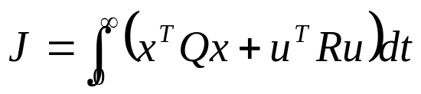
Methodology cont’
Linear Quadradic Regulator (LQR)
  Performance Index
    Q : State Weighting Positive Semi-Definite Matrix
    R : Input Weighting Positive Definite Matrix
    In the steady state case, LQR problem turns out to be the solution to the Algebraic Riccati Equation (ARE)
    Use ‘lqr’ command in MATLAB
    Use Newton’s Line Search Method to find optimum diagonal values of matrix Q and R

Slide 9
Analysis and result cont’
2-D model
  Assumption
    No output measurement error
    Both output displacements and velocities can be measured
    Noise path is the same with control input direction
  Constraints
    Max control gain value of 100
    (max absolute value of any element of ‘K’ matrix).

Slide 10
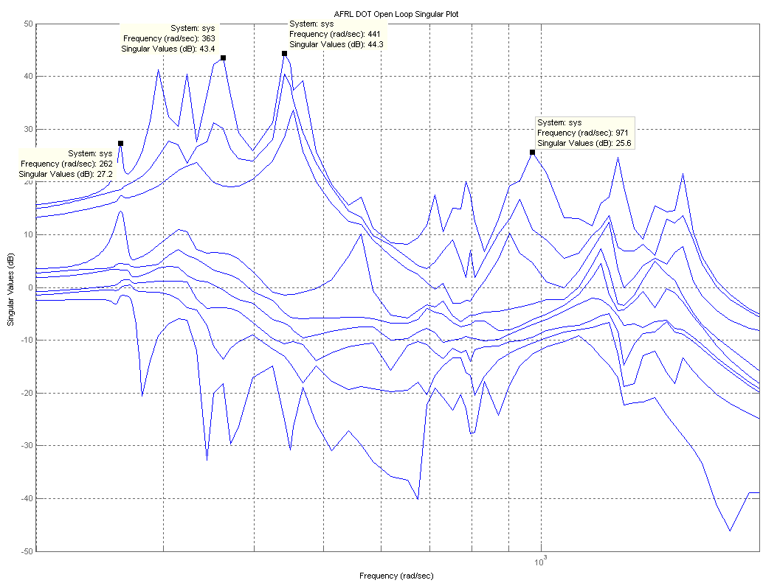
Analysis and result
AFRL Model singular value plot
  Used to develop Open-Loop (2-D model) System Analysis

Slide 11
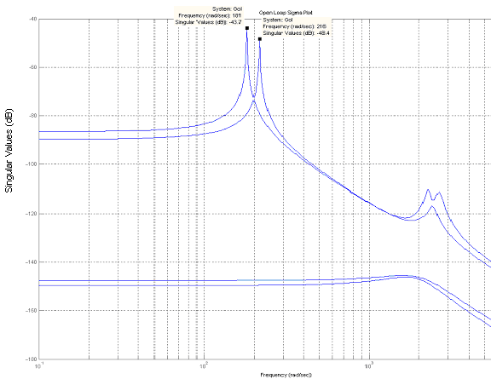
Analysis and result
Open-Loop System Analysis (2-D model)
  2-D Planar Model

Slide 12








Analysis and result
Open-Loop System Modes
Open-Loop System Measurement RMS
  Noise intensity : Objective function result : 4.1718
 | 1st mode | 2nd mode | 3rd mode | 4th mode | 5th mode | 6th mode
Eignvalue ( ) |  |  |  |  | 0 | 0
Damping | 5.29e-002 | 4.56e-002 | 3.62e-003 | 4.33e-003
 | Planar Model ( ) |  | AFRL Model ( )
Mirror “1” | Tilt Error | 143 | 143.3 | A segment X-tilt
 | Piston Error | 2028.9 | 46.68 | A segment piston
Mirror “2” | Tilt Error | 143 | 170.5 | C segment X-tilt
 | Piston Error | 2028.9 | 60.58 | C segment piston

Slide 13
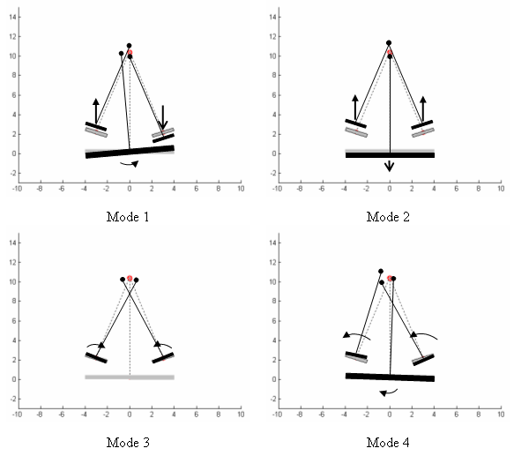
Analysis and result
Open-Loop System Modes
  See Matlab Animation

Slide 14
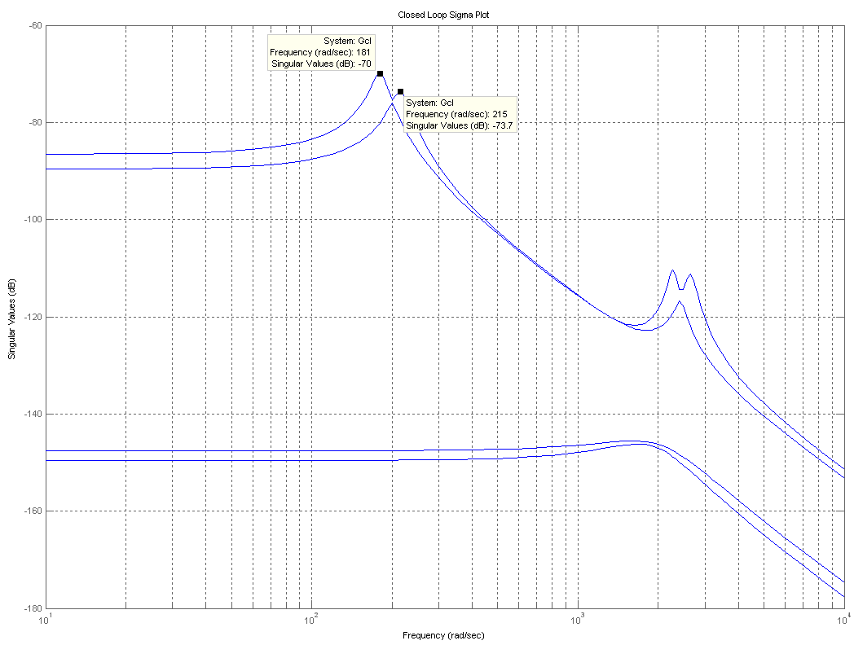
Analysis and result
Closed-Loop System
  (3rd & 4th mode changed)

Slide 15








Analysis and result
Closed-Loop System
  (3rd & 4th mode changed)
  Objective function result : 0.2164
  (5.2 % of open-loop result )
 | Open Loop |  | Closed Loop
 | 3rd mode | 4th mode | 3rd mode | 4th mode
Eigenvalue
Damping

Slide 16
Analysis and result
Closed-Loop System Measurement RMS
 | Open-loop system ( ) |  | Closed-loop system ( )
Mirror “1” | Tilt Error | 143 | 32.6
 | Piston Error | 2028.9 | 457.5
Mirror “2” | Tilt Error | 143 | 32.6
 | Piston Error | 2028.9 | 457.5

Slide 17
Analysis and result
Closed-Loop System (Eigenvector assigned)
  Optimum Mode Shape
 | Mode Shape
 | 3rd Mode |  | 4th Mode
 | Open Loop | Desired | Open Loop | Desired
z₁ z₂ z_{b} θ₁ θ₂ θ_{b} | 0 0 0 0.7071 -0.7071 0 | -0.7054 -0.7054 0.0282 0.0456 -0.0456 0 | 0.2699 -0.2699 0 0.6256 0.6256 -0.2674 | -0.7054 -0.7054 0.0282 0.0456 -0.0456 0

Slide 18
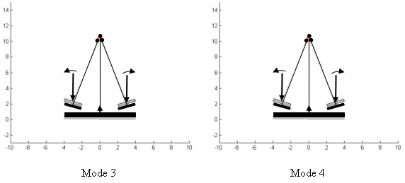
Analysis and result
Closed-Loop System (Eigenvector assigned)
  Optimum Mode Shape
  See Matlab Animation

Slide 19

Analysis and result
Closed-Loop System (Eigenvector assigned)
  Objective function result : 0.1244
  (2.98 % of open-loop result)
    Max gain value : 9.99
  Constraint max gain value : 100
    Objective function result : 0.2164
    (almost the same result of the eigenvalue assignment)

Slide 20
Analysis and result
Closed-Loop System (LQR)
  Assumption
    All the control usage has the same importance
    (all the actuators are equally weighted = 0.1)
  Performance Index

Slide 21
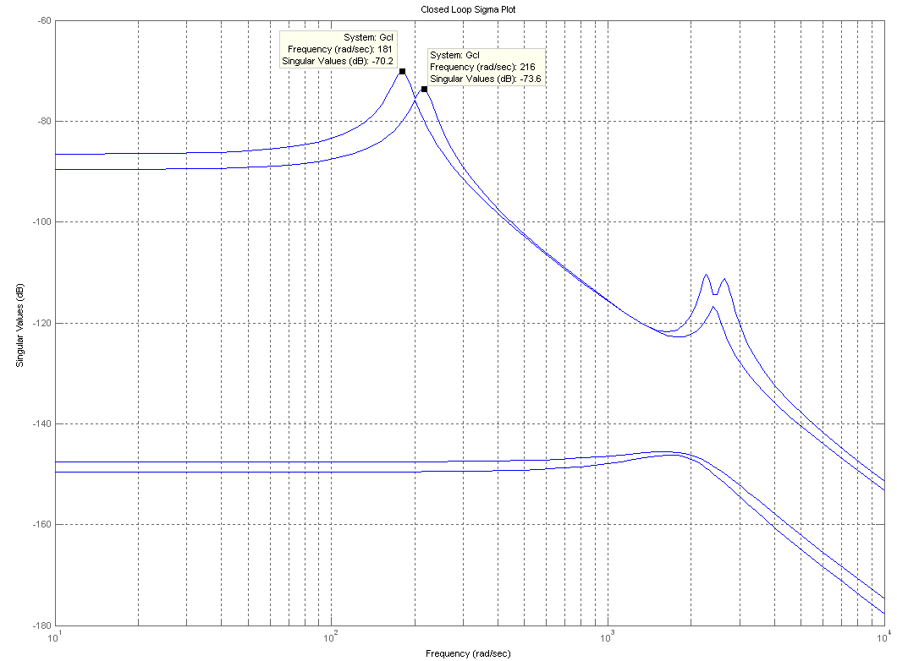
Analysis and result
Closed-Loop System (LQR)
  Objective function result : 0.2164
    (Almost the same result of the eigenvalue assignment)

Slide 22
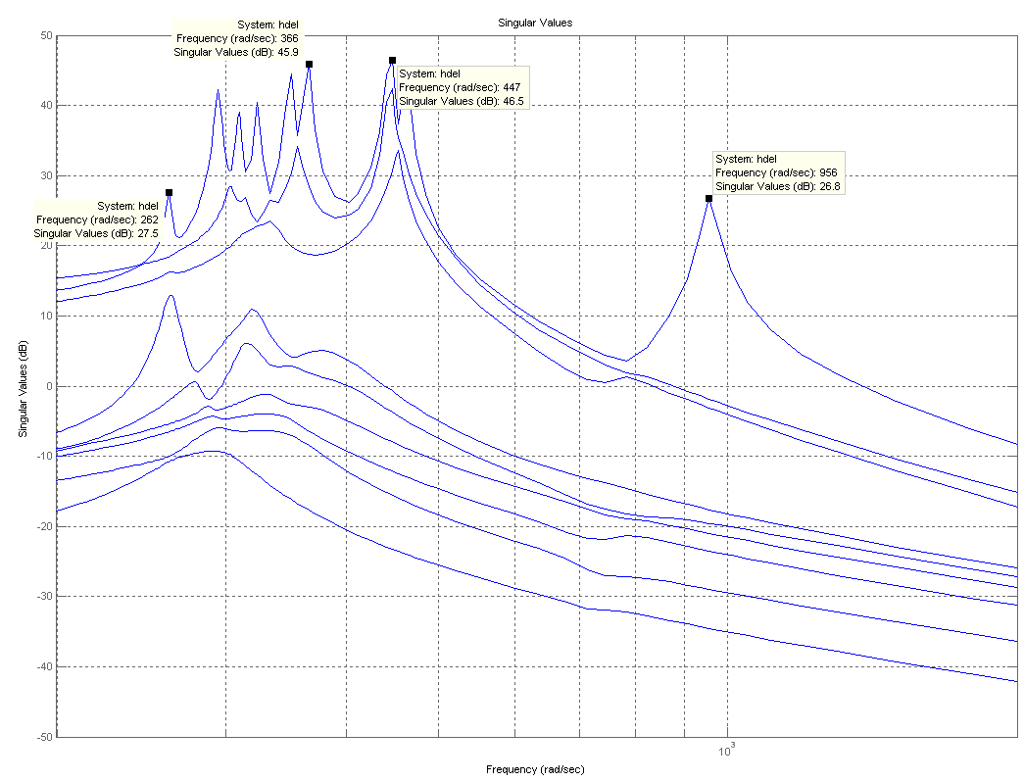
Analysis and result
AFRL DOT System
  Model reduction (20 states, 9 inputs and 9 outputs)

Slide 23
Analysis and result
Assumption
  Existence of Perfect State Estimator
  Noise path is the same with control input direction
Constraints
  Max control gain value of 1
  (max absolute value of any element of ‘K’ matrix).

Slide 24
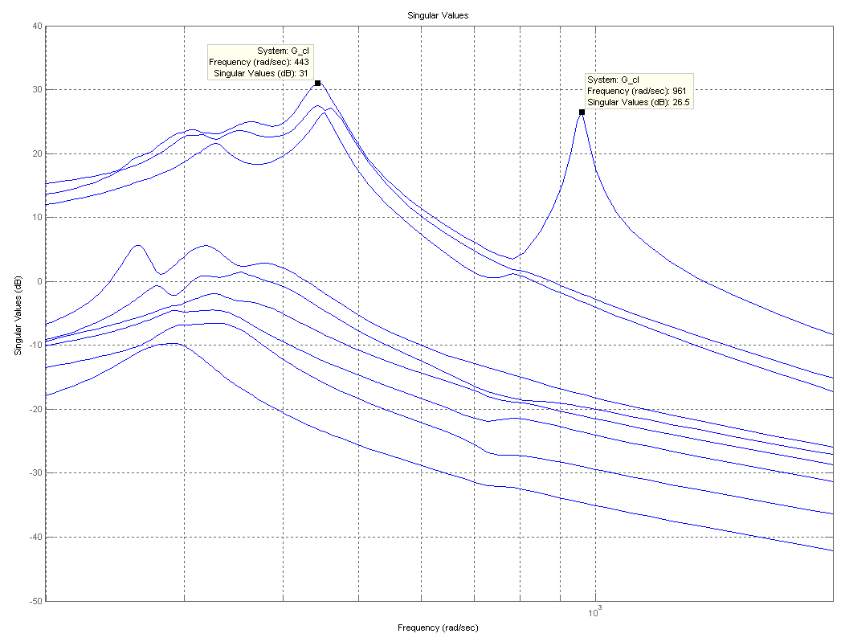
Analysis and result
Closed-Loop System (Eigenvalue assigned)

Slide 25

Analysis and result
Closed-Loop System (Eigenvalue assigned)
    Objective function result : 0.287
    (12 % of open-loop system result)
Segment | D.O.F. | Open-Loop Jitter (Reduced Model) | Closed-Loop Jitter (Reduced Model) | Units (rms)
A | piston | 1773.2 | 598.4 | nm
 | X-tilt | 143.7 | 51.6 | nrad
 | X-tilt | 144.8 | 52.2 | nrad
B | piston | 1136.6 | 276 | nm
 | X-tilt | 105.3 | 22.5 | nrad
 | X-tilt | 112.8 | 33.1 | nrad
C | piston | 4368.3 | 1557.6 | nm
 | X-tilt | 172.4 | 53.9 | nrad
 | X-tilt | 122.1 | 51.1 | nrad

Slide 26
Conclusions
Advantage
  Computing time reduction w/r LQR
    finding 2 variables rather than 8 in LQR (2-D Planar Model)
    finding desired eigenvector using 2 necessary condition range space
Disadvantage
  Selecting target modes
    Dependence on allowable max control gain value
  Little contribution of assigning the desired eigenvectors w/r assigning eigenvalues.

Slide 27
Recommendations
Researching with the existence of an estimator
Decoupling the ‘tip’ and ‘tilt’ modes
The planar model should be expanded
to a 3-D model
Flexible body effects of the individual mirrors
Notes:
2nd
This approach could be used combined with optical modes (zernikes) to further enhance control by decoupling the optical modes.

Slide 28
Questions ?
Notes:
2nd
This approach could be used combined with optical modes (zernikes) to further enhance control by decoupling the optical modes.

Slide 29
Backup
Notes:
2nd
This approach could be used combined with optical modes (zernikes) to further enhance control by decoupling the optical modes.

Slide 30
Overview
Background
Objectives
Problem Statement
Developing Equations of Motion
Methodology
Analysis and result (Planar Model)
Analysis and result (AFRL’s model)
Conclusion
Questions

Slide 31
Background cont’
Sparse vs. Full
  Filled Aperture
    Circle circumscribing primary mirror is filled with glass (mirror)
  Sparse-Aperture
    Circle circumscribing primary mirror is not filled with glass (mirror)
    Achieve higher diameters without mass of filled aperture
    Proper designs allow image processing to reconstruct perfect image
VS.

Slide 32
Objectives cont’
Disturbance Rejection
  LQG (LQR, LQE)
  Eigenstructure Assignment Technique
Notes:
In maintaining the focus of the primary mirror, several approach can be used such as LQG (LQR + LQE) and Eigenstructure Assignment Technique.

Slide 33
Background
Current NASA System
Problem
Next Generation Satellite

Slide 34
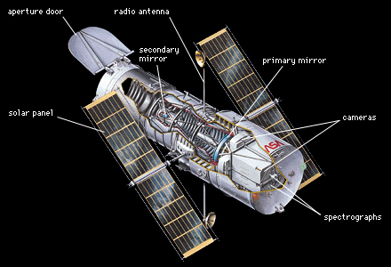
Background cont’
Current NASA System
  2.4 meter (~8 ft) dia primary
  Launched in 1990
  600 km (372 mile) orbit

Slide 35
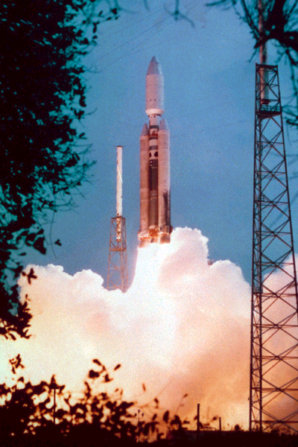
Background cont’
Problem: Launch Vehicles
  All available choices constrained by ~5 m diameter.
  Larger Shrouds Difficult
  (Drag, GNC, Manufacturing )
Notes:
GNC
Guidance, Navigation, and Control

Slide 36
Background cont’
Next Generation Satellite
  James Webb
  DOT
  (Deployable Optical Telescope)

Slide 37
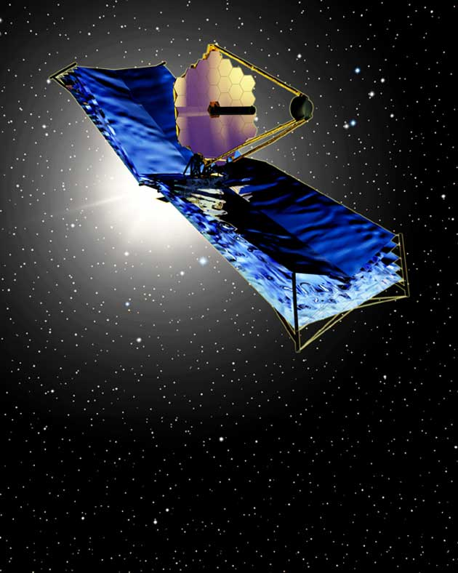
Background cont’
Next Generation Satellite
  James Webb
  DOT
  (Deployable Optical Telescope)

Slide 38
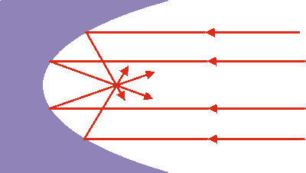
Objectives
Maintaining the Focus of Primary Mirror
  Vibration control/Disturbance Rejection

Slide 39

Problem Statement
General Dynamic System
  M : Mass Matrix
  C : Damping Matrix
  K : Stiffness Matrix
  D : Control Influence matrix

Slide 40
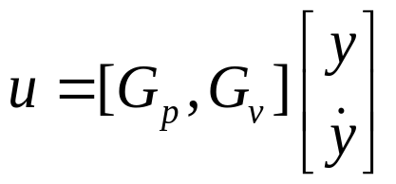
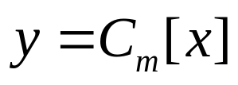
Problem Statement cont’
Output Feedback
  where
Closed-loop System

Slide 41
Problem Statement cont’
Objective Function
  V_{i} : variance of the i^{th} output
  P_{i} : Penalty of i^{th} output
How to select the control gain matrices such that it minimizes the objective function

Slide 42
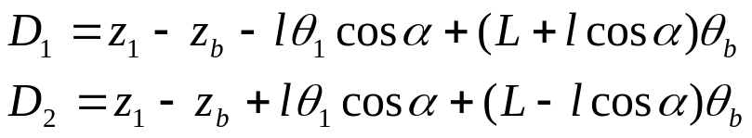
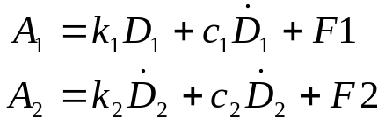
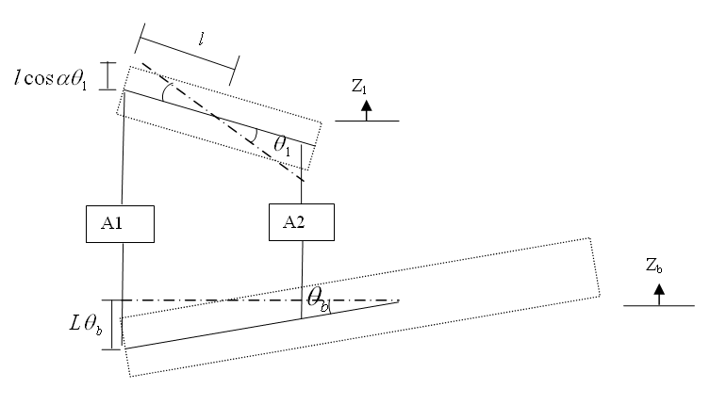
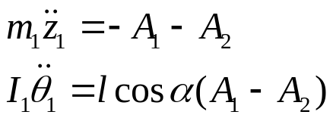
Developing EOMs cont’
Mirror 1

Slide 43
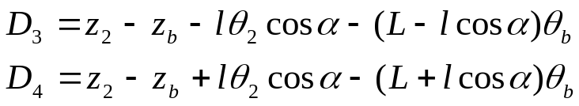
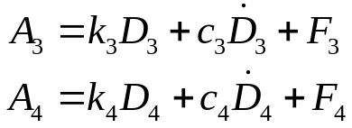
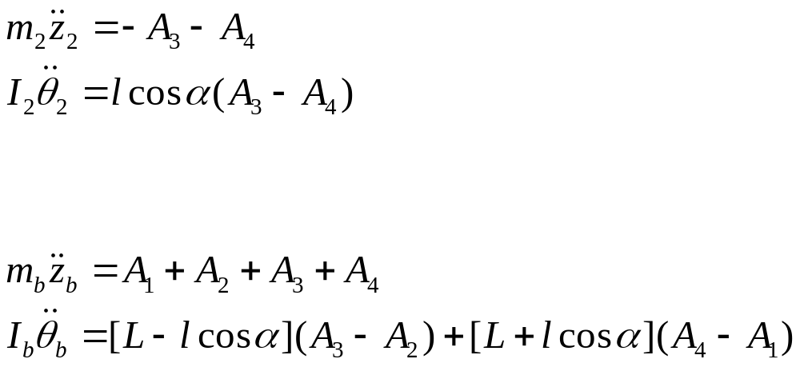
Developing EOMs cont’
Mirror 2
Base

Slide 44
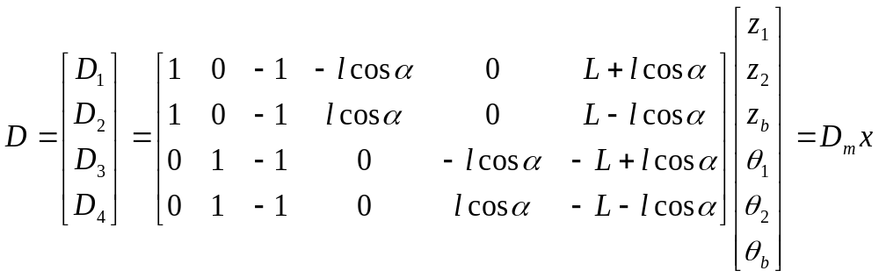
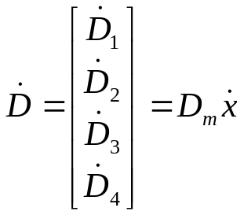
Developing EOMs cont’
Linearization

Slide 45
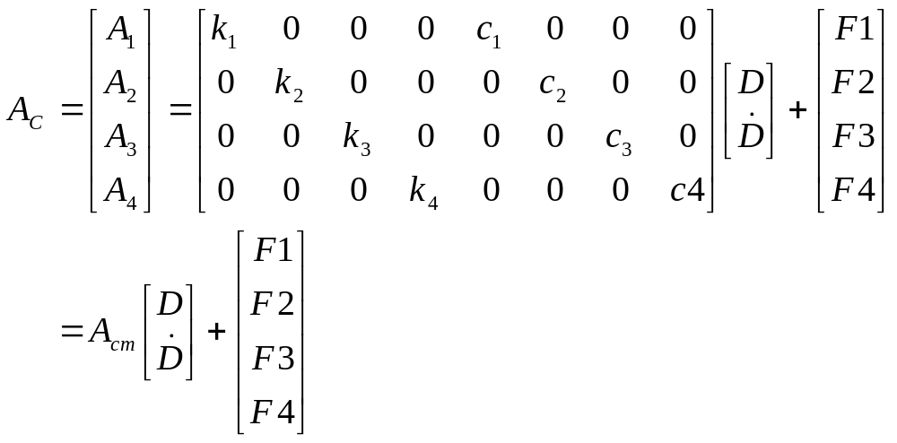
Developing EOMs cont’
Linearization cont’

Slide 46
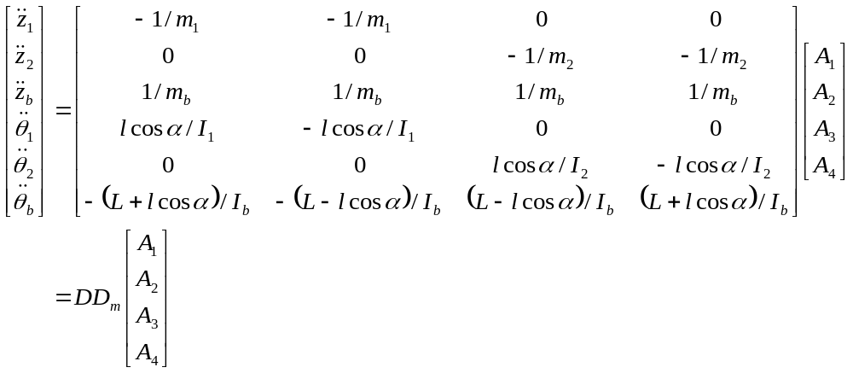
Developing EOMs cont’
Linearization cont’

Slide 47

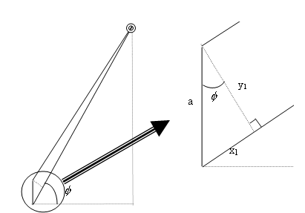



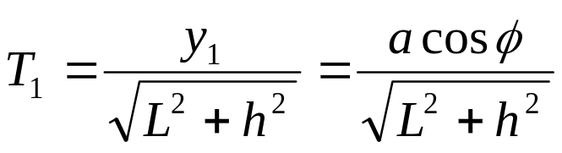
Developing EOMs cont’
Error metric
(Mirror 1 Vertical Movement w/t base)
where

Slide 48

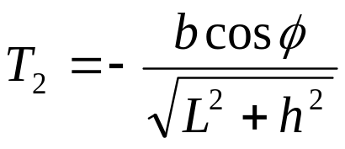

Developing EOMs cont’
Error metric
(Mirror 2 Vertical Movement w/t base)
where

Slide 49

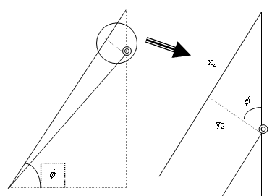

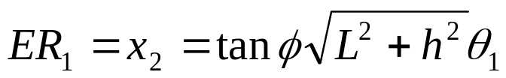

Developing EOMs cont’
Error metric
(Mirror 1 Rotational Movement )

Slide 50


Developing EOMs cont’
Error metric
(Mirror 2 Rotational Movement )

Slide 51

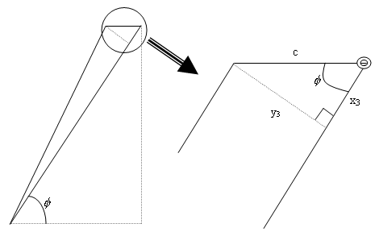



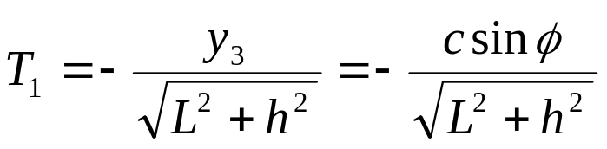

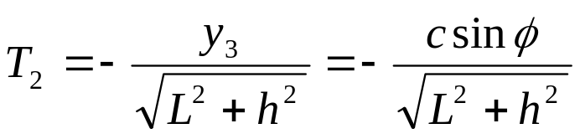
Developing EOMs cont’
Error metric
(Base Rotational Movement )
where

Slide 52
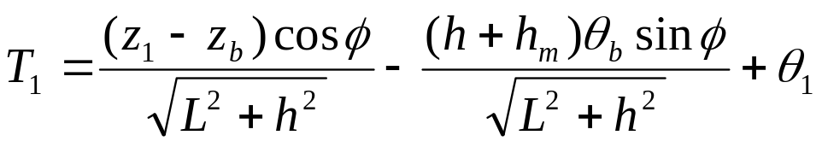
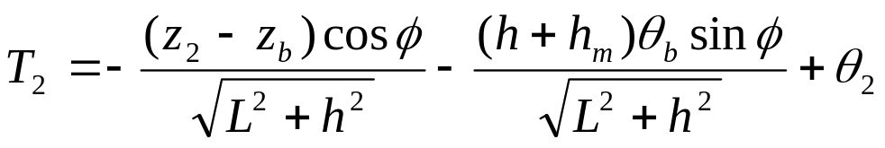
Developing EOMs cont’
Error metric
(Sum of all errors )

Slide 53

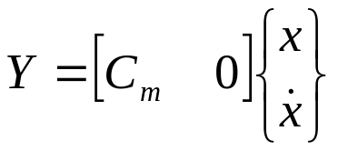

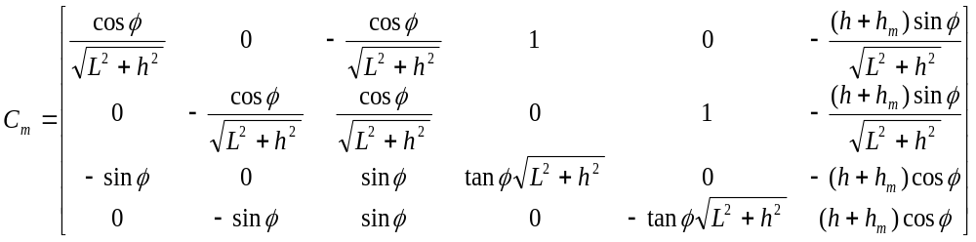
Developing EOMs cont’
Linearization
where

Slide 54
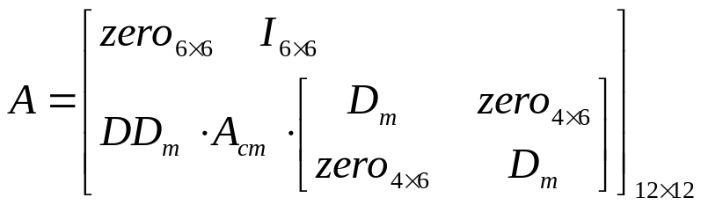
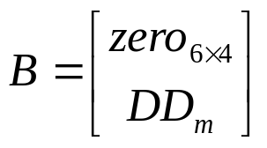


Developing EOMs cont’
State Space Form

Slide 55
Methodology
Performance Index
Response of Linear System to White Gaussian Noise Methodology
Stabilizable / Detectable system

Slide 56
Methodology cont’
Developing Eigenstructure Assignment
  Output Feedback
  Full-State Feedback
  Limited Measurement Data
  Determining Desired Eigenvalues
  Determining Desired Eigenvectors
Linear Quadradic Regulator (LQR)

Slide 57
Methodology cont’
Stabilizable / Detectable system
  stabilizable : “if all the unstable modes are controllable then the system is said to be stabilizable”
  detectable : “if all the unstable modes are observable, then the system is said to be detectable”

Slide 58





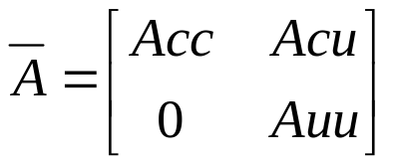
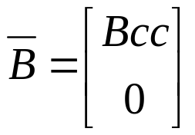
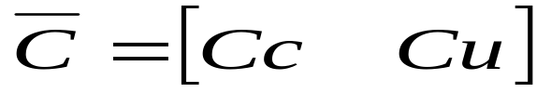
Methodology cont’
Stabilizable / Detectable system cont’
  controllability matrix
  singular value decomposition

Slide 59
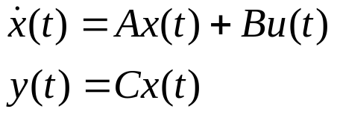



Methodology cont’
Performance Index
  Output variance=
P : penalty row vector

Slide 60



Methodology cont’
Response of Linear System to White Gaussian Noise Methodology
  Steady-State Case
  Lyapunov Equaion
  V : Noise Intensity
  state variance
  output variance
Notes:
Output variance is function of state variance and state variance (Q_bar) can be computed by by Lyapunov Equation.

Slide 61


Methodology cont’
Developing Eigenstructure Assignment
  Full-State Feedback algorithm
    subject to
    where
    v_{id} ; desired eigenvector
    v_{i} ; achievable eigenvector
    P_{i} ; a positive definite symmetric matrix whose elements are chosen to weight the difference between and for each element
Notes:
Full-state feedback case is one of the output feed back case.

Slide 62

Methodology cont’
Developing Eigenstructure Assignment
  Full-State Feedback algorithm cont’
  Lagrange multiplier method
Notes:
Full-state feedback case is one of the output feed back case.

Slide 63


Methodology cont’
Developing Eigenstructure Assignment
  Full-State Feedback algorithm cont’
  Matrix Form
    Where
    ( * denotes hermitian transpose )
Notes:
Full-state feedback case is one of the output feed back case.

Slide 64

Methodology cont’
Developing Eigenstructure Assignment
  Full-State Feedback algorithm cont’
    Post multiply by
    K= -WV⁻¹
Notes:
Full-state feedback case is one of the output feed back case.

Slide 65


Methodology cont’
Developing Eigenstructure Assignment
  Limited Measurement Data
    characteristic polynomial for matrix A
Notes:
The system already developed has state space model as shown.

Slide 66

Methodology cont’
Developing Eigenstructure Assignment
  Limited Measurement Data cont’
    characteristic polynomial for matrix A-BKC
    Stabilizing Speed Trade-off
Notes:
The system already developed has state space model as shown.

Slide 67


Methodology cont’
Developing Eigenstructure Assignment
  Determining Desired Eigenvectors
    1st Necessary condition
      The desired eigenvector associated with the closed-loop eigenvalue must lie in the subspace spanned by:

Slide 68

Methodology cont’
Developing Eigenstructure Assignment
  Determining Desired Eigenvectors
    2nd Necessary condition
    M_{CL} : Closed-loop Mode shape
    M_{OL} : Open-loop Mode shape
    {c} represents any linear combination of given basis

Slide 69

Methodology cont’
Developing Eigenstructure Assignment
  Determining Desired Eigenvectors
    2nd Necessary condition
      The desired eigenvector associated with the closed-loop eigenvalue must lie in the subspace spanned by:

Slide 70




Methodology cont’
Developing Eigenstructure Assignment
  Determining Desired Eigenvectors
    Find intersection space (V)

Slide 71

Methodology cont’
Developing Eigenstructure Assignment
  Determining Desired Eigenvectors
    Find intersection space (V)

Slide 72

Methodology cont’
Developing Eigenstructure Assignment
  Determining Desired Eigenvectors
    Best desired eigenvector (V_{id})
    Newton’s Line Search Method was used

Slide 73

Methodology cont’
Developing Eigenstructure Assignment
  Determining Desired Eigenvectors
    Find the best ratio between open-loop eigenvector (V_{OL}) and the best desired eigenvector (V_{id}) which satisfies max gain value constraint
      V_{ia} : assigned eigenvector
      V_{io} : open-loop system eigenvector
      V_{id} : best desired eigenvector
    Newton’s Line Search Method
Notes:
V_{ia} : assigned eigenvector
V_{io} : open-loop system eigenvector
V_{id} : best desired eigenvector

Slide 74
Analysis and result
2-D planar model
  Assumption
  Open-Loop System Analysis
  Closed-Loop System
    Eigenvalue assignment
    Eigenvector assignment
    LQR
AFRL DOT System

Slide 75

Analysis and result
Open-Loop System Analysis (2-D model)
  State space form was build to be close to AFRL model characteristics

Slide 76
Analysis and result
Assumed noise intensity
 | Noise direction ( Input # )
 | 1 | 2 | 3 | 4 | 5 | 6 | 7 | 8 | 9
Intensity | 0 | 131.0617 | 0 | 0 | 0 | 0 | 19.9437 | 322.9485 | 0

Slide 77

Analysis and result
Optical Performance
    Objective function result : 2.3629
Segment | D.O.F. | Open-Loop Jitter (Reduced Model) | Open-Loop Jitter (AFRL Model) | Units (rms)
A | piston | 1773.2 | 46.68 | nm
 | X-tilt | 143.7 | 168.44 | nrad
 | Y-tilt | 144.8 | 143.03 | nrad
B | piston | 1136.6 | 45.64 | nm
 | X-tilt | 105.3 | 106.57 | nrad
 | Y-tilt | 112.8 | 89.96 | nrad
C | piston | 4368.3 | 60.58 | nm
 | X-tilt | 172.4 | 170.5 | nrad
 | Y-tilt | 122.1 | 117.88 | nrad

